Slide 1
Device attestation for ads : a new paradigm
Vinod Panicker
Principal Product Manager
Amazon Ads Supply Quality

Slide 2
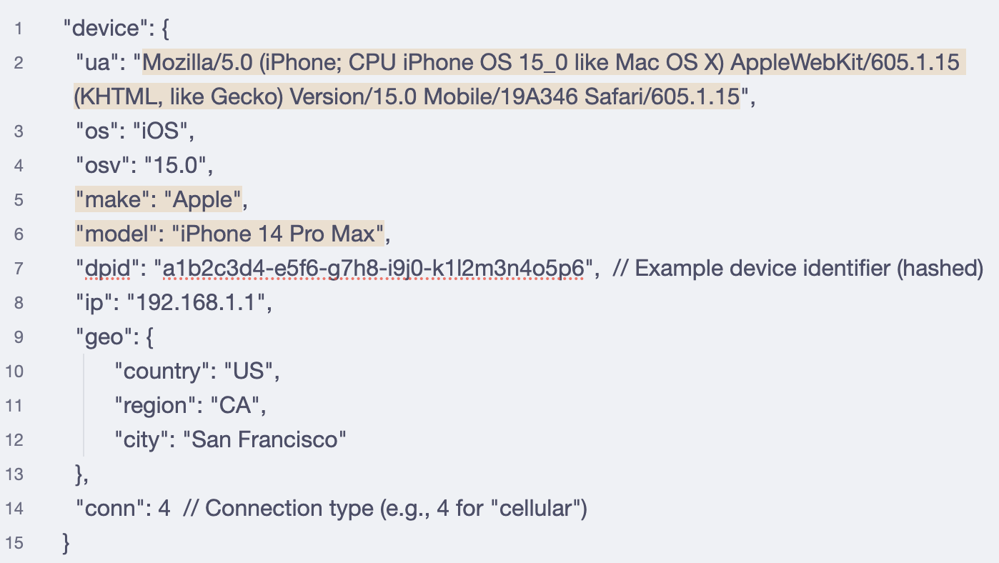
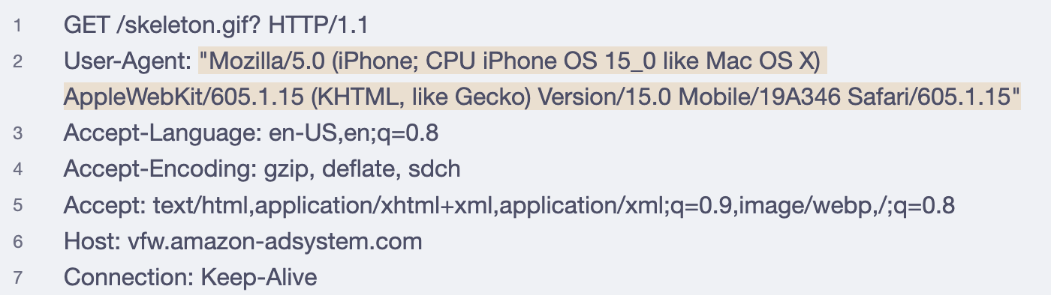
Device information in
bid requests and measurement
beacons

Slide 3
Ad spend distribution example
Wasted ad spend
+
Unavailable to legitimate publishers
Why is this a problem?
Waste for advertisers
Ad spend on spoofed devices is a waste for advertisers because it is IVT.
Zero-sum game for publishers
When ad spend takes place on spoofed supply, it leaves less ad spend to go around for legitimate publishers.

Slide 4






ads.txt and app-ads.txt
Publisher A
Publisher B
Reseller
DSP
The Reseller can spoof this traffic as coming from either publisher
Publisher C
Spoofed traffic

Slide 5



Requirements
Should be a
mechanism;
not reliant on
good intentions
Should be broadly
available to
ad buyers
Should be considerate
of privacy and
resource utilization
Device attestation: a potential solution

Slide 6




Privacy Pass for device attestation
HTTP-based standard
No persistent identifiers
Trusted party vouches
Strong security

Slide 7
Verification at measurement time
Device
Cloud services
Client
(App)
Verifier
(Measurement provider)
Attester
(Device manufacturer)
Issuer
(AWS WAF / Cloudflare / others)
Trust
Trust
Trust

Slide 8
Attestation flow
Device
Cloud services
Client
(App)
Verifier
(Measurement provider)
Attester
(Device manufacturer)
Issuer
(AWS WAF / Cloudflare / others)
Ad creative
w/Verifier
URL
Attestation call
Challenge for token
Request token
Verify Client
Request token
Token
Token
Token
Verify Token

Slide 9



Behind the scenes
Amazon Ads Traffic
Quality Verifier
Attestation SDK
Fire TV Attester
AWS WAF Issuer
Fire OS Privacy Pass service

Slide 10

Standardizing this capability
Privacy Pass Verifier
OM SDK + Attestation SDK
App
Fire TV Attester
Privacy Pass token Issuer
Fire OS Privacy Pass service

Slide 11

Supporting other Privacy Pass implementations via OM SDK
Privacy Pass Verifier
OM SDK + Attestation SDK
App
Apple Attester
Privacy Pass token Issuer
Private Access Tokens service

Slide 12
Standardizing device attestation via Open Measurement SDK
|
|
Other devices
Privacy Pass Verifier
(Measurement provider)
OM SDK + Attestation SDK
App
Device Attester
(Device manufacturer)
Privacy Pass token Issuer
(AWS WAF / Cloudflare / others)
On-device Privacy Pass capability

Slide 13




Let’s light this up!
Device
manufacturers
Support Privacy Pass
Measurement
Providers
Collaborate on
standardization
Publishers
Distinguish inventory
as genuine
Advertisers and
Agencies
Ask for attested
inventory to reduce
wastage

Slide 14
Thank you!

